Slide 1
Artificial Intelligence for Health Metricians, Week 9: Data Transformations
Abraham D Flaxman
Mar 2 & 4, 2015

Slide 2
Any questions?

Slide 3
Projects
What is a Baseline Model?
Notes:
Starting with decision trees. DM focuses on pruning methods, while ISL focuses on ensembles of trees. I’m saving ensembles for later, so the focus here is on trees, greedy construction, and pruning

Slide 4
Before, during, and after this week
Before this week: Read DM 7, implement and evaluate improved model one
During class: Learn tricks of the trade for data transformation, co-work on projects
Outside of classes:
Read (DM 8, ISL 8.2), finish Feature Engineering II exercise, implement and evaluate improved model 2 for class project.

Slide 5
Lecture 9 Outline
Homework solutions
Project check-ins
Data Transformations
Attribute Selection
Discretization
Projection
Sampling
Cleansing
Exercise 9: Feature Engineering II

Slide 6
Any (more) questions?

Slide 7
Lecture 9 Outline
Homework solutions
Project check-ins
Data Transformations
Attribute Selection
Discretization
Projection
Sampling
Cleansing
Exercise 9: Feature Engineering II

Slide 8
Lecture 9 Outline
Homework solutions
Project check-ins
Data Transformations
Attribute Selection
Discretization
Projection
Sampling
Cleansing
Exercise 9: Feature Engineering II

Slide 9
Improved Model Two
Make most important changes/additions to data and/or model
How does it compare to model one and baseline approach?
The results will be an annotated IPython notebook describing the improved model and how it compares to the baseline method.

Slide 10
Check-in (~5 min each)
What did you do in last week?
What will you do in next week?
What are you stuck on?
(This set of questions is part of “scrum”, in case you were wondering. Teams using this agile methodology are supposed to do it every day, while standing up.)

Slide 11
Lecture 9 Outline
Homework solutions
Project check-ins
Data Transformations
Attribute Selection
Discretization
Projection
Sampling
Cleansing
Exercise 9: Feature Engineering II

Slide 12
Data Transformations
Attribute Selection

Slide 13
Data Transformations
Discretization

Slide 14
Data Transformations
Projection

Slide 15
Data Transformations
Sampling

Slide 16
Data Transformations
Cleansing

Slide 17
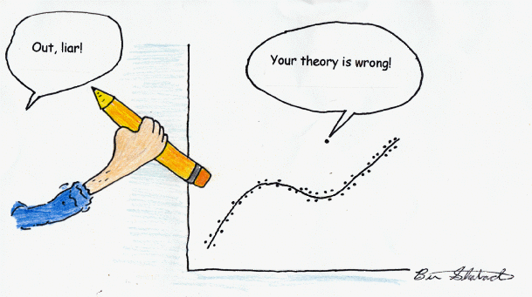
Cleansing
Notes:
From Statistics Cartoons by Ben Shabad - http://davidmlane.com/ben/cartoons.html

Slide 18
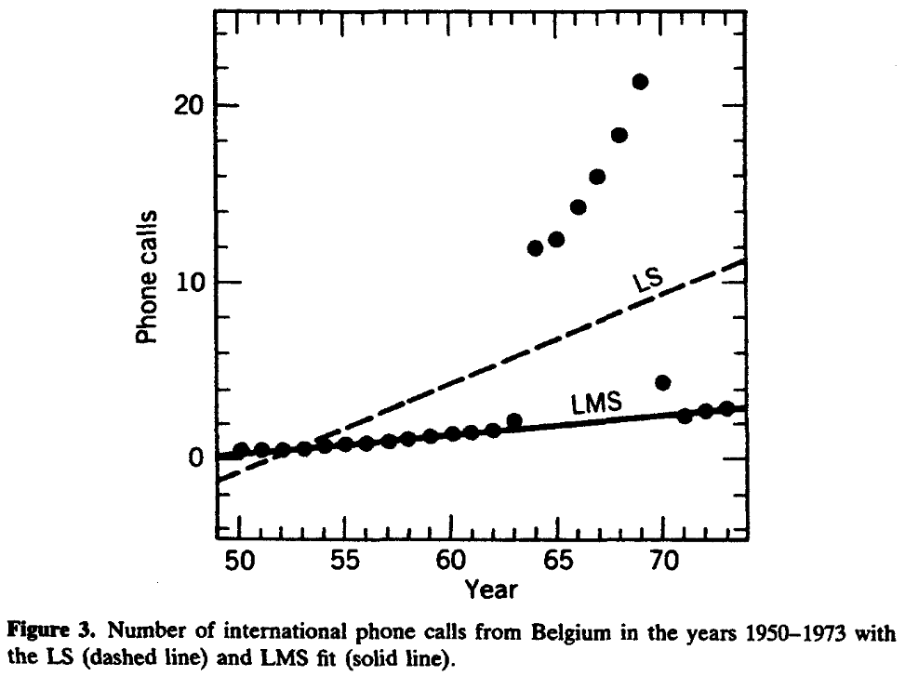
Notes:
From Robust Regression and Outlier Detection
By Peter J. Rousseeuw, Annick M. Leroy
Page 25
(and Data Mining, Ch 8)

Slide 19
Data Transformations
Multiclass labels

Slide 20
Data Transformations
Calibration

Slide 21
Lecture 9 Outline
Homework solutions
Project check-ins
Data Transformations
Attribute Selection
Discretization
Projection
Sampling
Cleansing
Exercise 9: Feature Engineering II

